Slide 1

Surviving & Thriving in the midst of a global pandemic
U of O Data Analytics Bootcamp
November 2020
Danica Tiegs, Lauren Gardner,
Siara Leininger, Stacey Wai

Slide 2
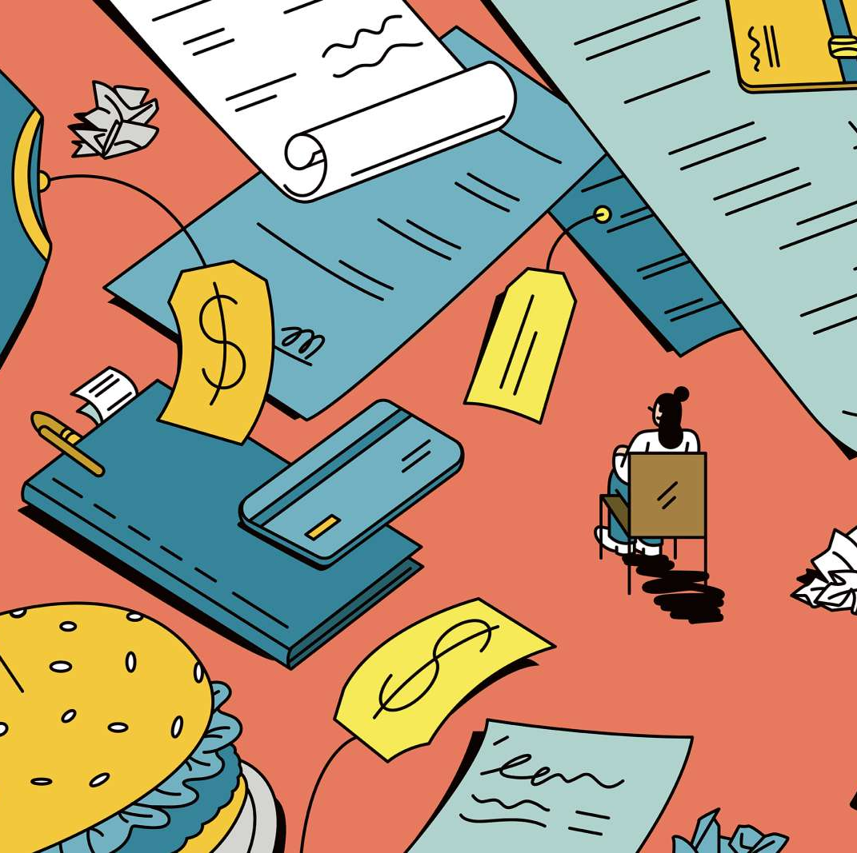
What items are necessary for survival?
Hypothesis: When the world is faced with fear and panic, certain items will unexpectedly become household necessities
How does spending correlate to a pandemic?
Expected trends v unexpected trends
Does spending change after a ”new normal” is established?
If we are faced with a second Apocalypse, what items should I have on hand?
Notes:
Stacey:
Hypothesis -

Slide 3
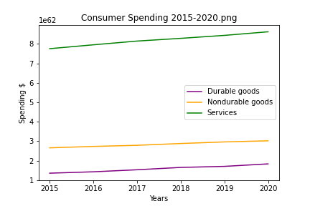
How we spent our money the past 5 years..
Data sourced from BEA (US Bureau of Economic Analysis) official PCE report
Notes:
Stacey & Danica
Danica – how we chose the data and cleansed data
Stacey:
Hypothesis -
Over the past 5 years we saw categories grew at ave rate of :
Durable goods: 6.24%
Nondurable: 2.58%
Services: 2.14%

Slide 4
Spending in the midst of panic and fear…
Notes:
Stacey

Slide 5
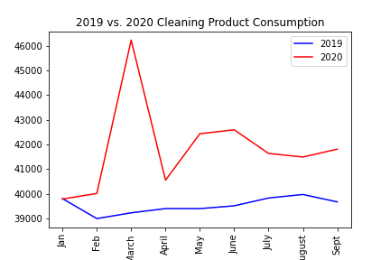
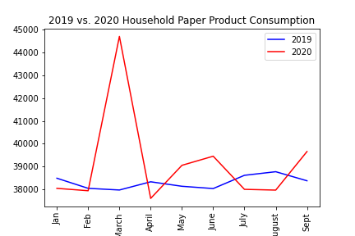

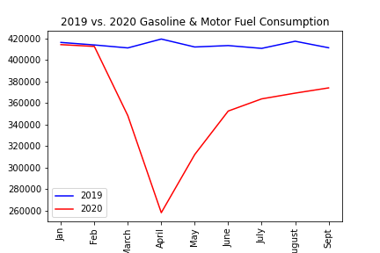
Panic Spending
Notes:
Danica
Non-durable
Prescription & non-prescription drugs
Cleaning supplies
Question from Siara: Would it make more sense to include the food purchase graph instead of the gasoline graph? The food graph has a similar shape to the other two graphs, and I feel like that is an important trend we noticed that we haven’t really highlighted. I added a graph but we can definitely delete it if it doesn’t make sense.

Slide 6
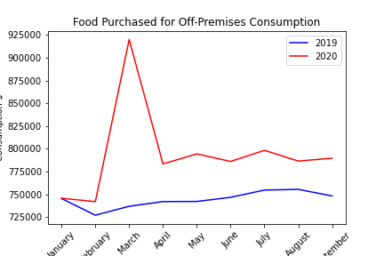
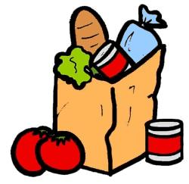
Chaos and food…
This Photo by Unknown Author is licensed under CC BY-SA
Notes:
Lauren

Slide 7
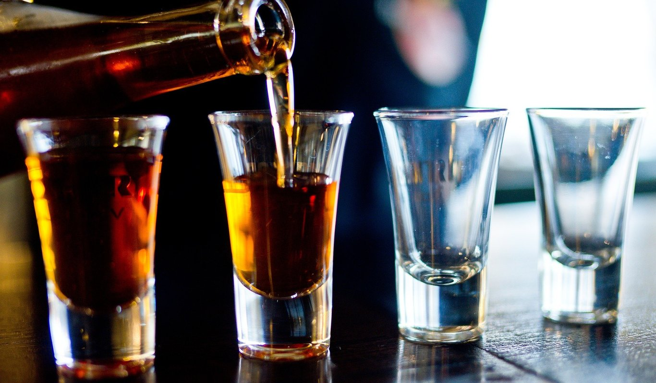
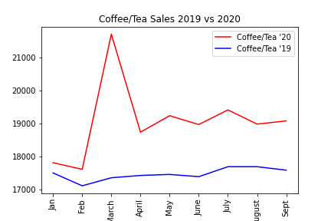
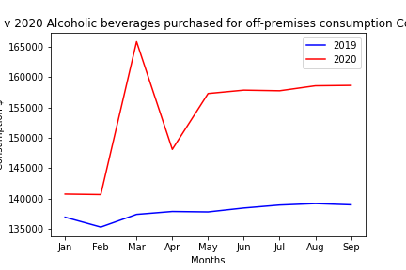
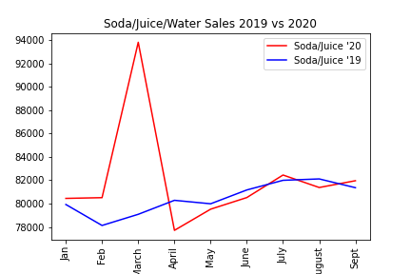
When in panic… always drink more
Notes:
Lauren

Slide 8
Adjusting to a new normal…
Notes:
Lauren
We noticed purchasing spikes in 3 main categories:
Productivity
Comfort
Entertainment

Slide 9

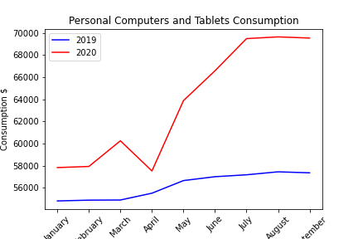
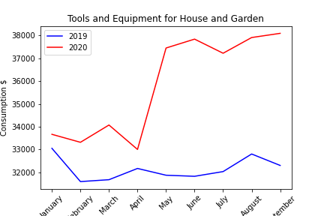
Productivity in a new world
Notes:
Siara
As people adjust to life in an apocalyptic world where they do not get to venture out of the house as much, they need to find ways to stay productive. These purchasing trends reflect this.

Slide 10
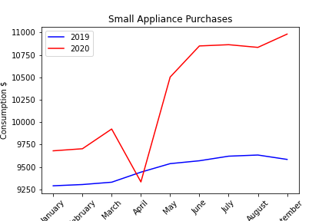
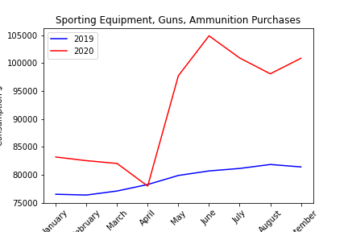
Comfort, Safety & Entertainment
Notes:
As people are spending more time at home, they want to feel comfortable and safe.

Slide 11
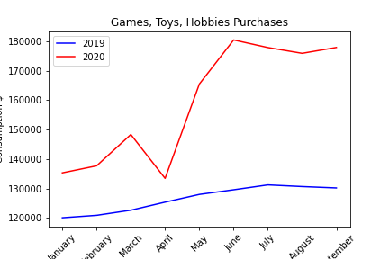
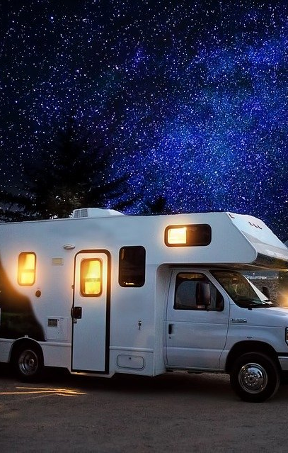
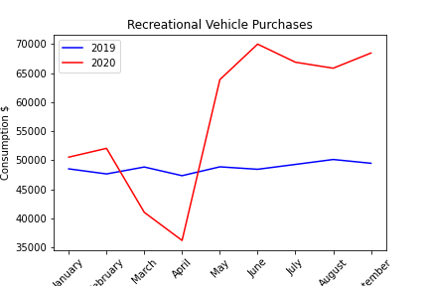
Notes:
Siara
We noticed a large spike in purchasing items that can be used for home entertainment.
You can use these types of items for fun without needing to be in a large group.

Slide 12
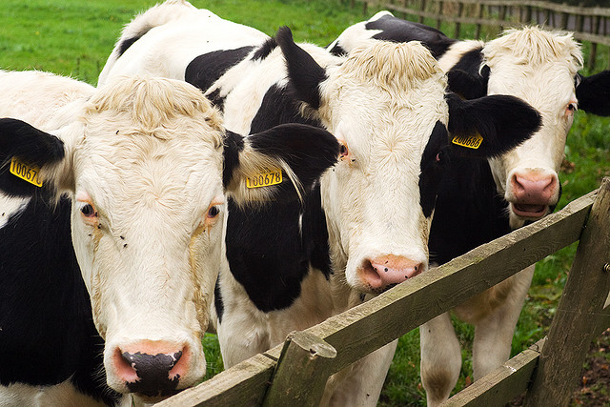
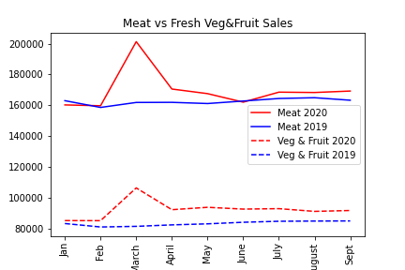
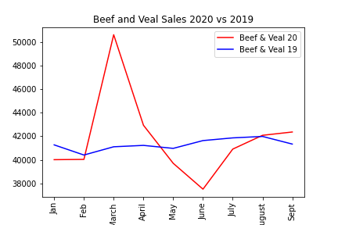
Unexpected Meat Trends
This Photo by Unknown Author is licensed under CC BY-SA
Notes:
Lauren

Slide 13


Overcoming data analysis obstacles
Working with BEA’s output
Vague category descriptions
Narrowing the scope
Output
This Photo by Unknown Author is licensed under CC BY
This Photo by Unknown Author is licensed under CC BY-NC
Notes:
Stacey

Slide 14

Preparing for a second wave…
Items for survival
Items for thriving
Q & A?
This Photo by Unknown Author is licensed under CC BY-SA-NC
Notes:
Lauren
Conclusions – how to prepare for for an apocalypse (what items to have on hand) and then how to thrive post apocalypse economy
Mention items to barter
Notes from Siara:
First question: Items to include in a Doomsday Bunker:
Food, Household Cleaning Products, Household Paper Products
Second question: Items to buy while others are panicking:
At-home productivity items, at-home comfort items, at-home entertainment items

